Slide 1

TRANSCENDENTAL FUNCTIONS

Slide 2
OBJECTIVES
At the end of the lesson, the students are expected to:
use the Log Rule for Integration to integrate a rational functions.
integrate exponential functions.
integrate trigonometric functions.
integrate functions of the nth power of the different trigonometric functions.
use Walli’s Formula to shorten the solution in finding the antiderivative of powers of sine and cosine.

Slide 3
integrate functions whose antiderivatives involve inverse trigonometric functions.
use the method of completing the square to integrate a function.
review the basic integration rules involving elementary functions.
integrate hyperbolic functions.
integrate functions involving inverse hyperbolic functions.

Slide 4
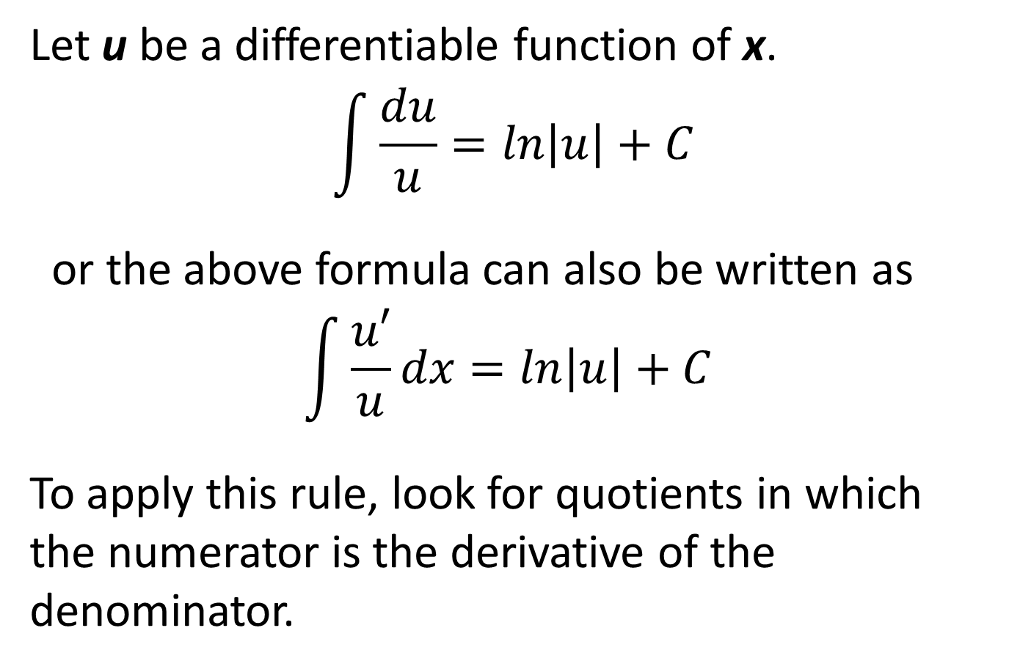
LOG RULE FOR INTEGRATION
Let u be a differentiable function of x.
$$\int{\frac{du}{u}=ln\left|u\right|+C}$$
or the above formula can also be written as
$$\int{\frac{u′}{u}dx=ln\left|u\right|+C }$$
To apply this rule, look for quotients in which the numerator is the derivative of the denominator.

Slide 5
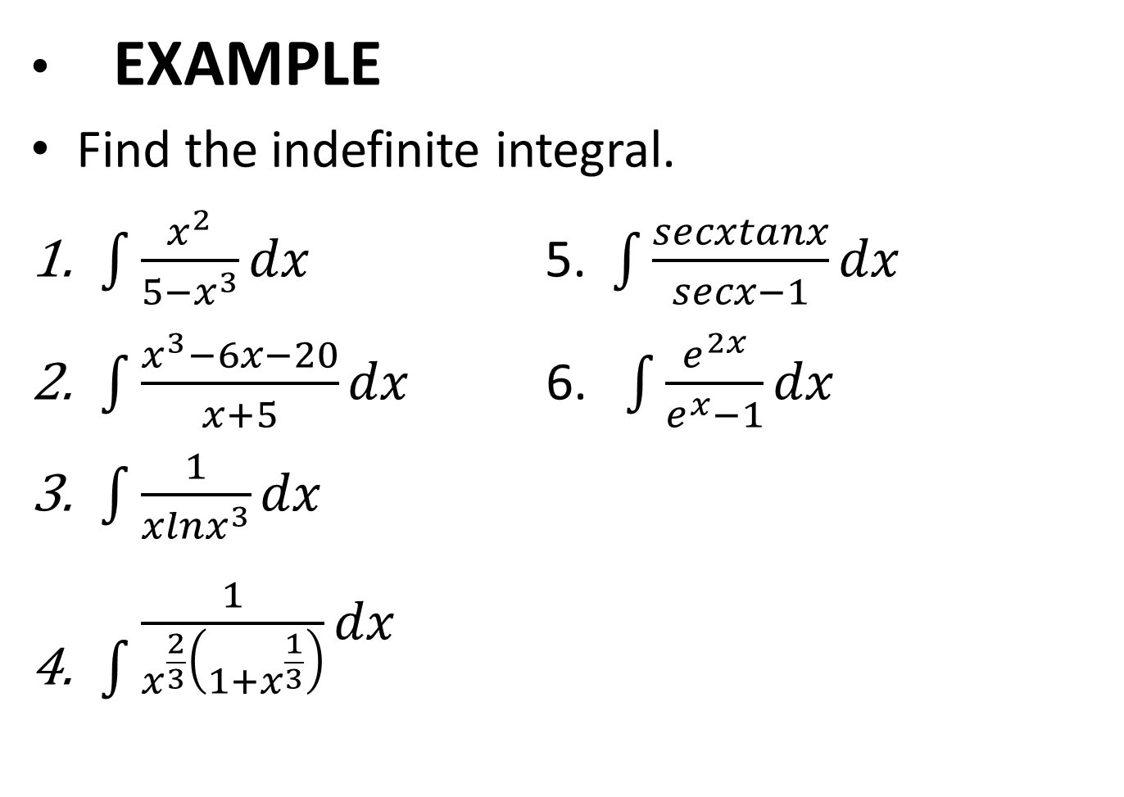
EXAMPLE
Find the indefinite integral.
$\int{\frac{x^{2}}{5−x^{3}}dx}$ 5. $\int{\frac{secxtanx}{secx−1}dx}$
$\int{\frac{x^{3}−6x−20}{x+5}dx}$ 6. $\int{\frac{e^{2x}}{e^{x}−1}dx}$
$\int{\frac{1}{xlnx^{3}}dx}$
$\int{\begin{aligned}\frac{1}{x^{\frac{2}{3}}\left(1+x^{\frac{1}{3}}\right)}dx \\ \end{aligned}}$

Slide 6

INTEGRATION OF EXPONENTIAL FUNCTIONS
Let u be a differentiable function of x.
$\int{e^{u}du= e^{u}+c}$
$\int{a^{u}du= \frac{a^{u}}{lna}}$ + c

Slide 7
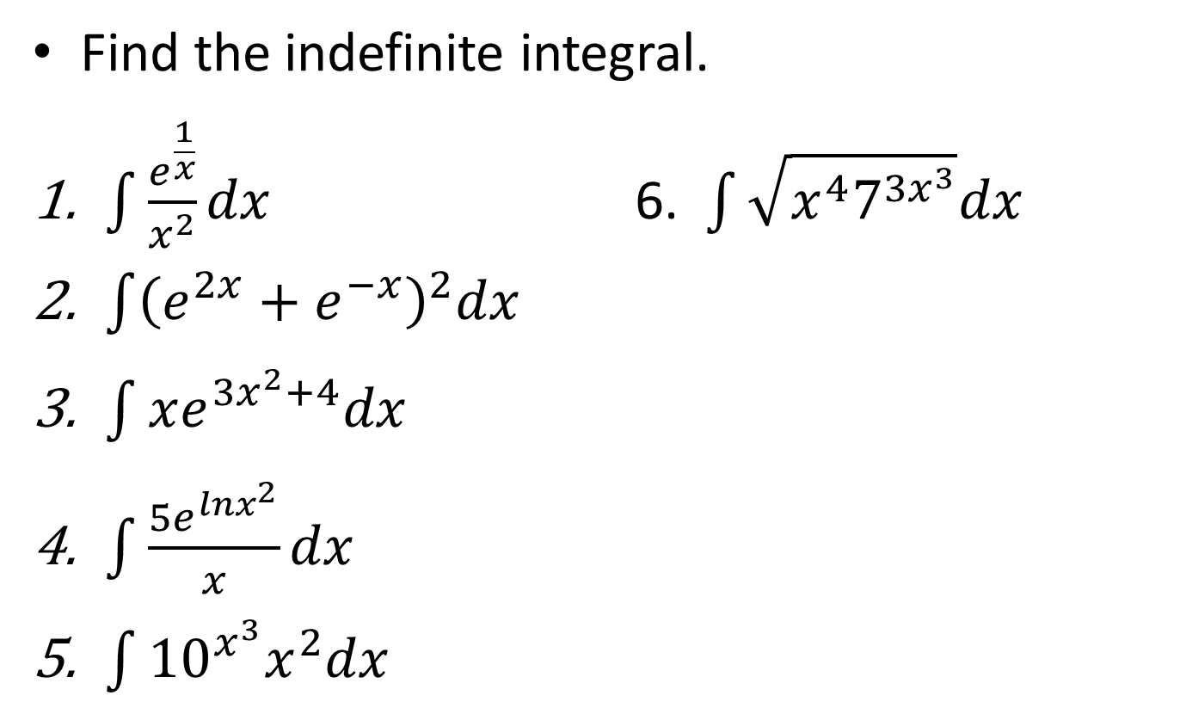
EXAMPLE
Find the indefinite integral.
$\int{\frac{e^{\frac{1}{x}}}{x^{2}}dx}$ 6. $\int{\sqrt{x^{4}7^{{3x}^{3}}}dx}$
$\int{{\left(e^{2x}+e^{−x}\right)}^{2}dx}$
$\int{xe^{{3x}^{2}+4}dx}$
$\int{\frac{5e^{lnx^{2}}}{x}dx}$
$\int{{10}^{x^{3}}x^{2}dx}$

Slide 8
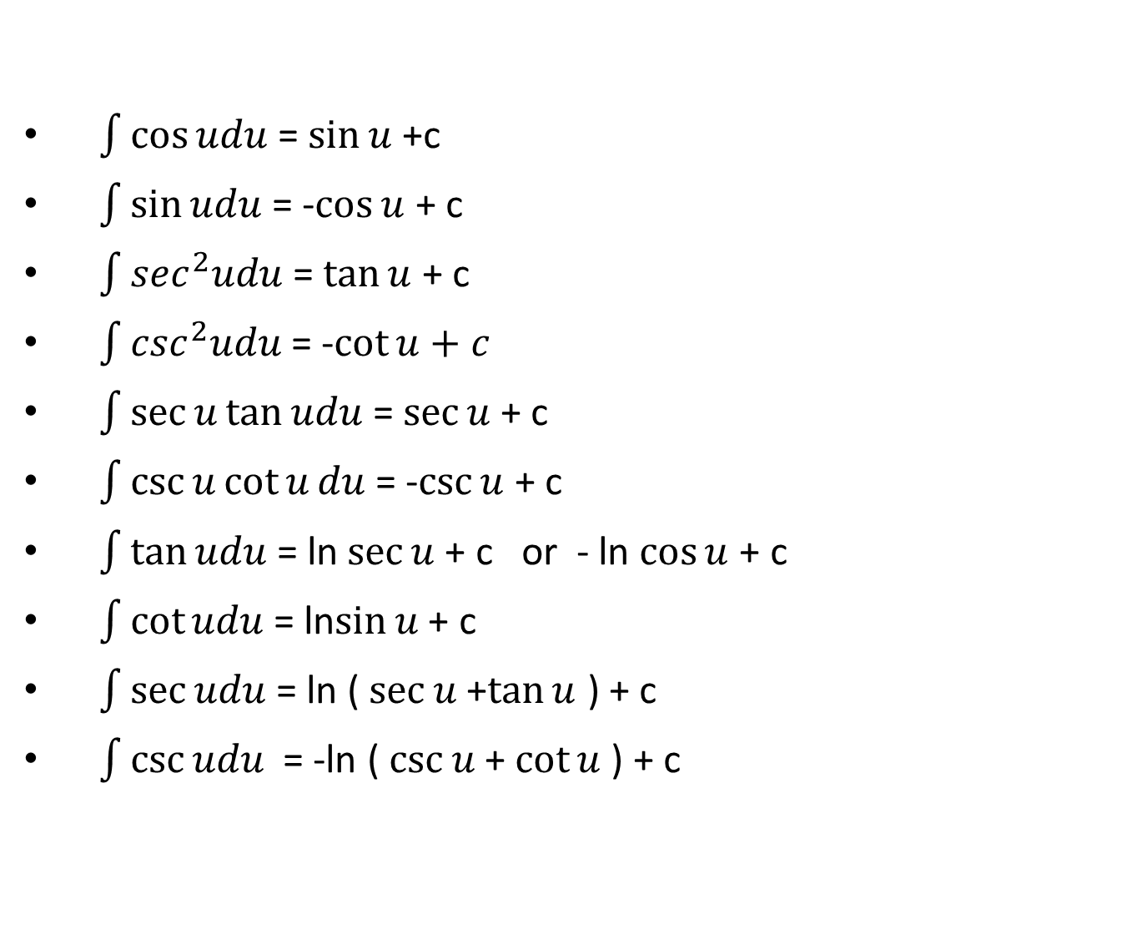
BASIC TRIGONOMETRIC FUNCTIONS INTEGRATION FORMULAS
$\int{\cos{udu}}$ = $\sin{u}$ +c
$\int{\sin{udu}}$ = -$\cos{u}$ + c
$\int{\sec^{2}udu}$ = $\tan{u}$ + c
$\int{\csc^{2}udu}$ = -$\cot{u}+c$
$\int{\sec{u\tan{udu}}}$ = $\sec{u}$ + c
$\int{\csc{u\cot{u}du}}$ = -$\csc{u}$ + c
$\int{\tan{udu}}$ = ln$\sec{u }$+ c or - ln$\cos{u}$ + c
$\int{\cot{udu}}$ = ln$\sin{u }$+ c
$\int{\sec{udu}}$ = ln ( $\sec{u}$ +$\tan{u}$ ) + c
$\int{\csc{udu}}$ = -ln ( $\csc{u}$ + $\cot{u}$ ) + c

Slide 9
In all these formulas, u is an angle. In dealing with integrals involving trigonometric functions, transformations using the trigonometric identities are almost always necessary to reduce the integral to one or more of the standard forms.

Slide 10
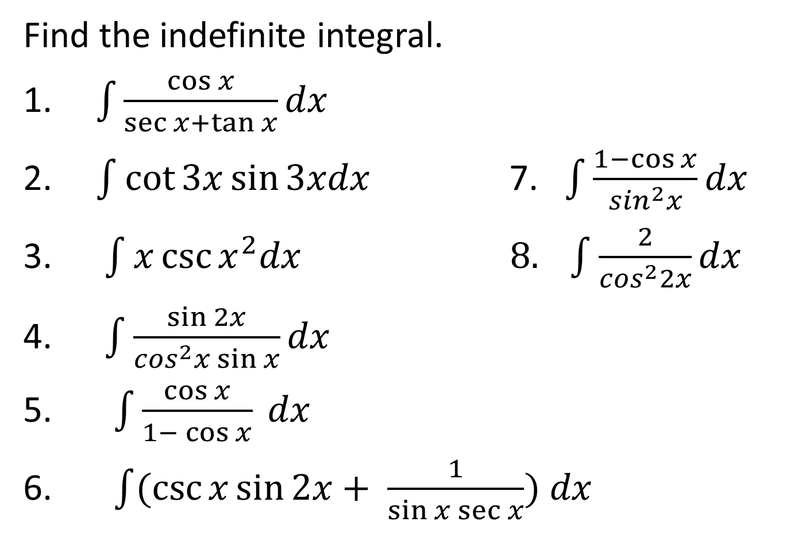
EXAMPLE
Find the indefinite integral.
1. $\int{\frac{\cos{x}}{\sec{x+\tan{x}}}dx}$
2. $\int{\cot{3x\sin{3xdx}}}$ 7. $\int{\frac{1−\cos{x}}{\sin^{2}x}}dx$
3. $\int{x\csc{x^{2}dx}} 8. \int{\frac{2}{\cos^{2}2x}dx}$
4. $\int{\frac{\sin{2x}}{\cos^{2}x\sin{x}}dx}$
5. $\int{\frac{\cos{x}}{1− \cos{x}}} dx$
6. $\int{(\csc{x\sin{2x+ \frac{1}{\sin{x\sec{x}}}) dx}}}$

Slide 11
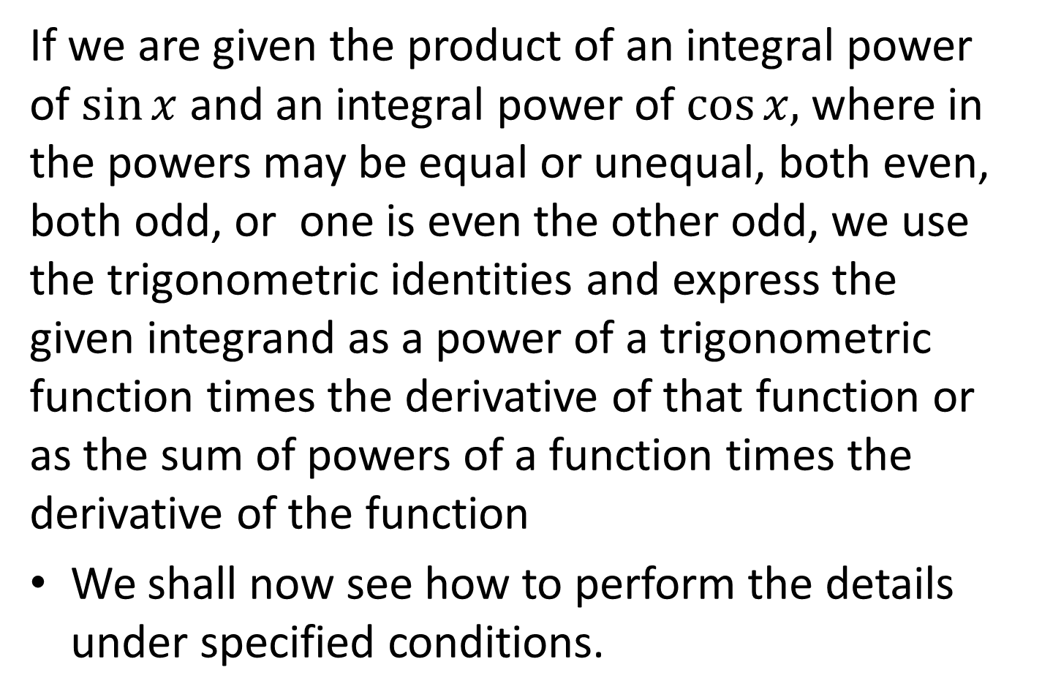
TRANSFORMATION OF TRIGONOMETRIC FUNCTIONS
If we are given the product of an integral power of $\sin{x}$and an integral power of $\cos{x,}$ where in the powers may be equal or unequal, both even, both odd, or one is even the other odd, we use the trigonometric identities and express the given integrand as a power of a trigonometric function times the derivative of that function or as the sum of powers of a function times the derivative of the function
We shall now see how to perform the details under specified conditions.

Slide 12
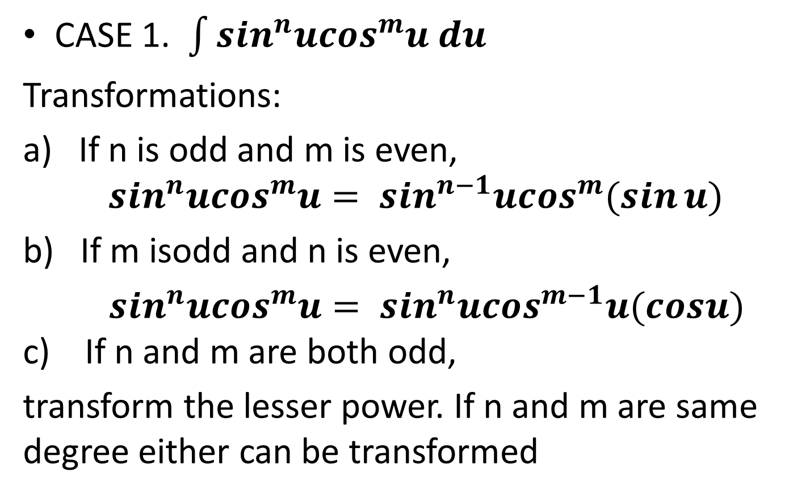
POWERS OF SINE AND COSINE
CASE 1. $\int{\sin^{n}u\cos^{m}u du}$
Transformations:
a) If n is odd and m is even, $\sin^{n}u\cos^{m}u= \sin^{n−1}u\cos^{m}(\sin{u)}$
b) If m isoddand n is even,
$\sin^{n}u\cos^{m}u= \sin^{n}u\cos^{m−1}u(cosu)$ c) If n and m are both odd,
transform the lesser power. If n and m are same degree either can be transformed

Slide 13
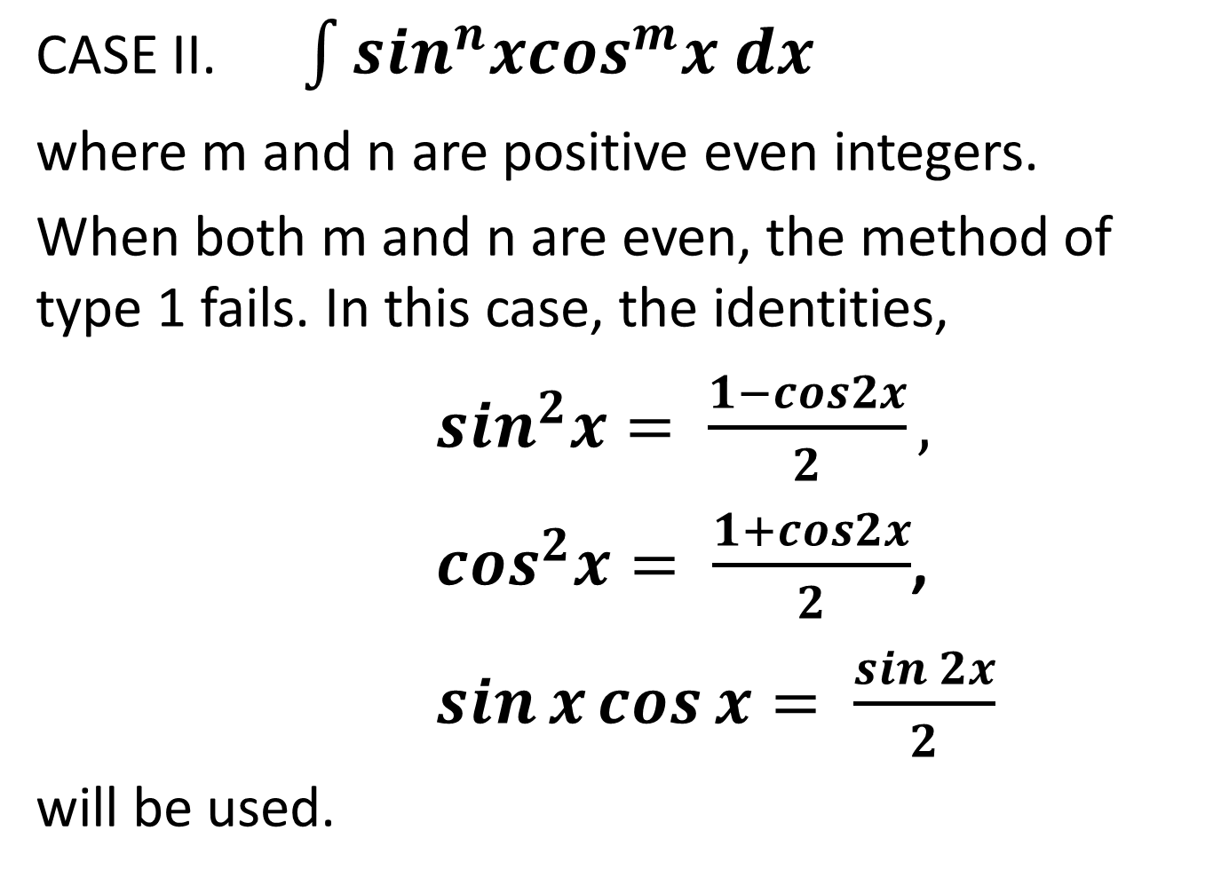
CASE II. $\int{\sin^{n}x\cos^{m}x dx}$
where m and n are positive even integers.
When both m and n are even, the method of type 1 fails. In this case, the identities,
$\sin^{2}x= \frac{1−cos2x}{2},$
$\cos^{2}x= \frac{1+cos2x}{2}$,
$\sin{x\cos{x= \frac{\sin{2x}}{2}}}$
will be used.

Slide 14
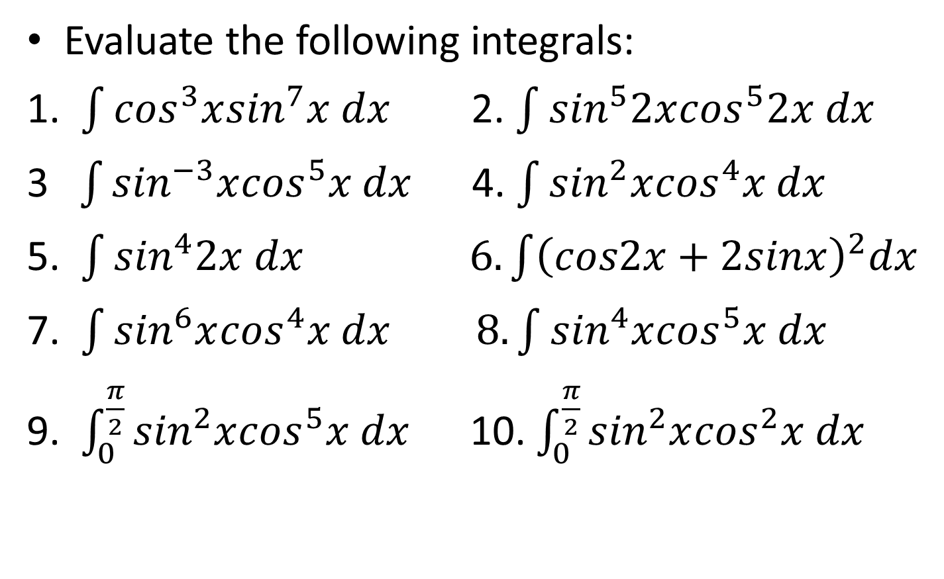
EXAMPLE
Evaluate the following integrals:
1. $\int{\cos^{3}x\sin^{7}x dx}$ 2. $\int{\sin^{5}2x\cos^{5}2x dx}$
3$\int{\sin^{−3}x\cos^{5}x dx}$ 4. $\int{\sin^{2}x\cos^{4}x dx}$
5. $\int{\sin^{4}2x dx}$$6. \int{{\left(cos2x+2sinx\right)}^{2}dx}$
7.$\int{\sin^{6}x\cos^{4}x dx} 8. \int{\sin^{4}x\cos^{5}x dx}$
9. $\int_{0}^{\frac{π}{2}}{\sin^{2}x\cos^{5}x dx}$ 10. $\int_{0}^{\frac{π}{2}}{\sin^{2}x\cos^{2}x dx}$

Slide 15
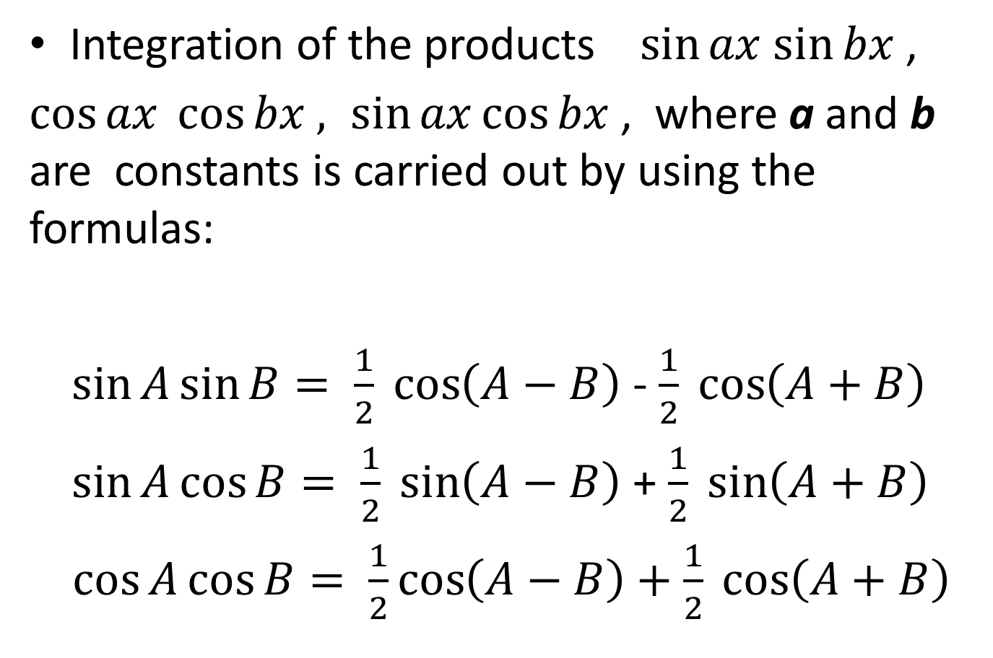
PRODUCT OF SINE AND COSINE
Integration of the products $\sin{ax}$$\sin{bx}$ ,
$\cos{ax \cos{bx , \sin{ax\cos{bx }}}}$, where a and b are constants is carried out by using the formulas:
$\sin{A\sin{B= \frac{1}{2} \cos\left(A−B\right)}}$- $\frac{1}{2} \cos\left(A+B\right)$
$\sin{A\cos{B= \frac{1}{2} \sin\left(A−B\right)}}$+ $\frac{1}{2} \sin\left(A+B\right)$
$\cos{A\cos{B= \frac{1}{2}}}\cos\left(A−B\right)+\frac{1}{2} \cos\left(A+B\right)$

Slide 16
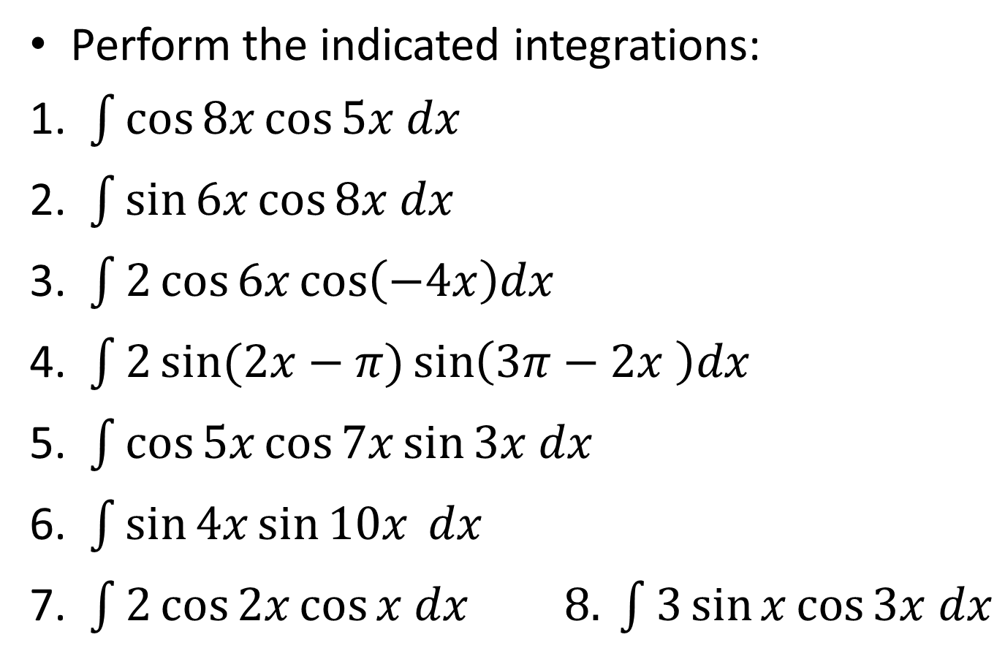
EXAMPLE
Perform the indicated integrations:
1. $\int{\cos{8x\cos{5x dx}}}$
2. $\int{\sin{6x\cos{8x dx}}}$
3. $\int{2\cos{6x\cos\left(−4x\right)dx}}$
4. $\int{2\sin{(2x−π)\sin\left(3π−2x \right)dx}}$
5. $\int{\cos{5x\cos{7x\sin{3x dx}}}}$
6. $\int{\sin{4x\sin{10x}}} dx$
7. $\int{2\cos{2x\cos{x dx}}} 8. \int{3\sin{x\cos{3x dx}}}$

Slide 17
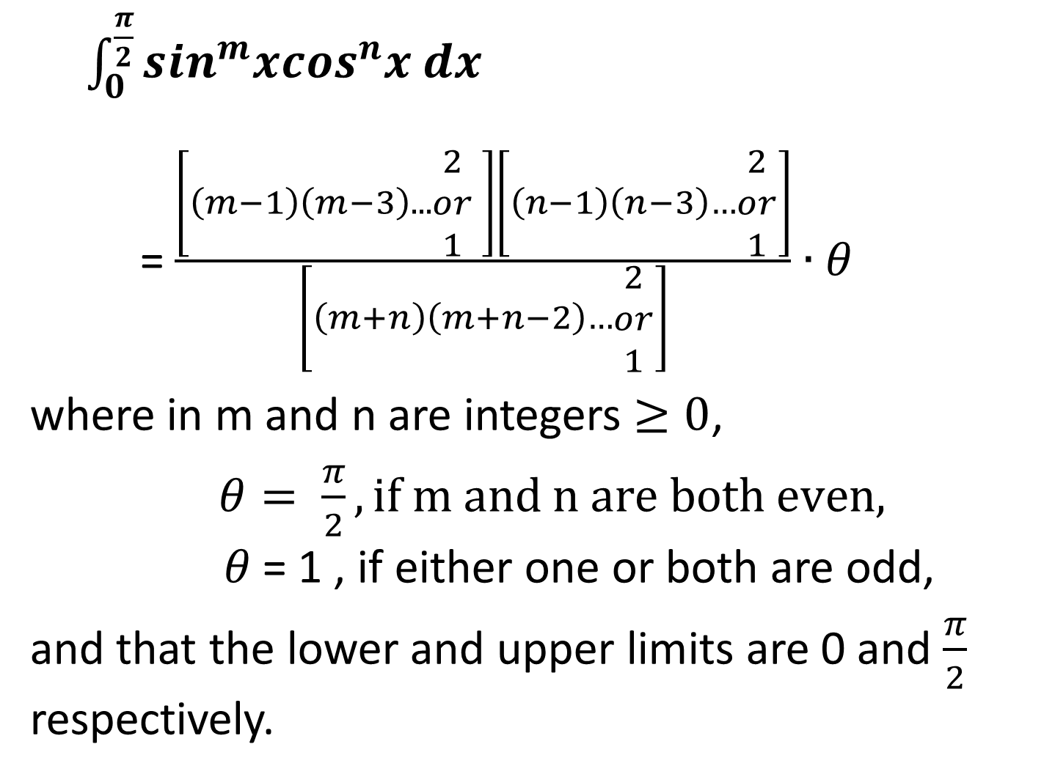
WALLIS’ FORMULA
$\int_{0}^{\frac{π}{2}}{\sin^{m}x\cos^{n}x dx}$
=$\frac{\left[\left(m−1\right)\left(m−3\right)...\begin{matrix}2 \\ or \\ 1\end{matrix} \right]\left[\left(n−1\right)\left(n−3\right)…\begin{matrix}2 \\ or \\ 1\end{matrix}\right]}{\left[\left(m+n\right)\left(m+n−2\right)…\begin{matrix}2 \\ or \\ 1\end{matrix}\right]}∙θ$
where in m and n are integers $≥0$,
$θ= \frac{π}{2}, if m and n are both even,$$θ$= 1 , if either one or both are odd,
and that the lower and upper limits are 0 and $\frac{π}{2}$ respectively.

Slide 18
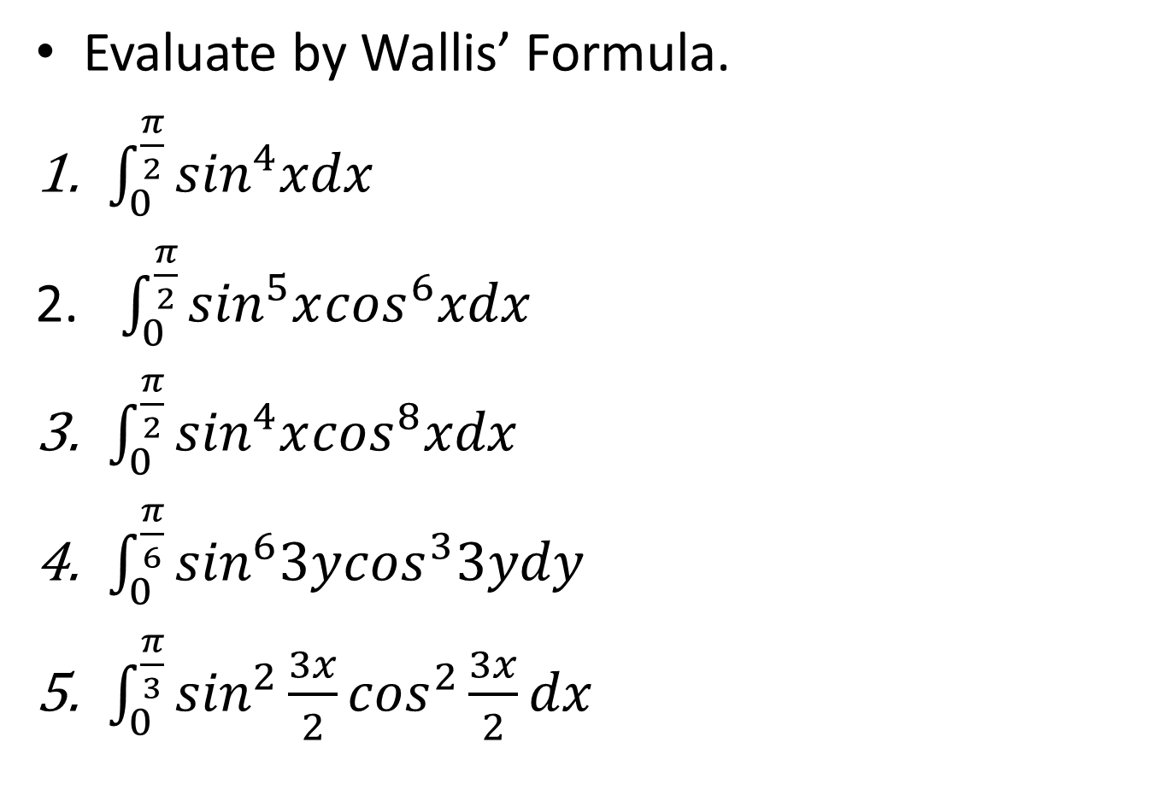
EXAMPLE
Evaluate by Wallis’ Formula.
$\int_{0}^{\frac{π}{2}}{\sin^{4}xdx}$
$\int_{0}^{\frac{π}{2}}{\sin^{5}x\cos^{6}xdx}$
$\int_{0}^{\frac{π}{2}}{\sin^{4}x\cos^{8}xdx}$
$\int_{0}^{\frac{π}{6}}{\sin^{6}3y\cos^{3}3ydy}$
$\int_{0}^{\frac{π}{3}}{\sin^{2}\frac{3x}{2}\cos^{2}\frac{3x}{2}dx}$

Slide 19
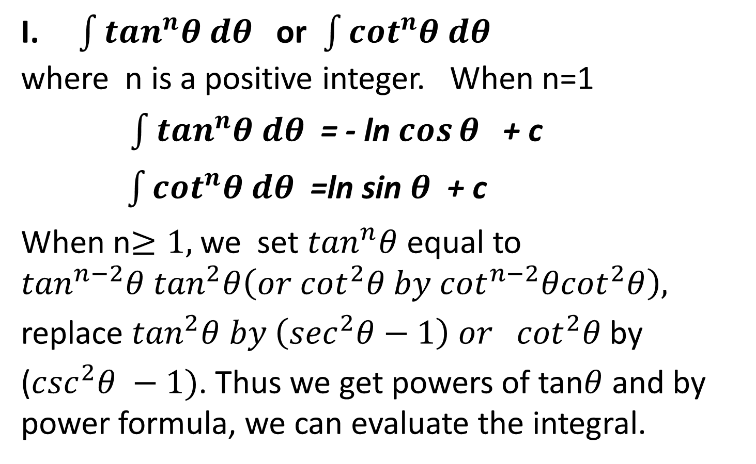
POWERS OF TANGENT AND SECANT (COTANGENT AND COSECANT)
I. $\int{\tan^{n}θ dθ}$ or $\int{\cot^{n}θ dθ}$ where n is a positive integer. When n=1
$\int{\tan^{n}θ dθ}$= - ln$\cos{θ }$ + c
$\int{\cot^{n}θ dθ}$ =ln sin $θ$ + c
When n$≥1,$we set $\tan^{n}θ$ equal to $\tan^{n−2}θ \tan^{2}θ\left(or \cot^{2}θ by \cot^{n−2}θ\cot^{2}θ\right),$
replace $\tan^{2}θ by \left(\sec^{2}θ−1\right) or \cot^{2}θ$by
($\csc^{2}θ −1)$. Thus we get powers of tan$θ$ and by power formula, we can evaluate the integral.

Slide 20
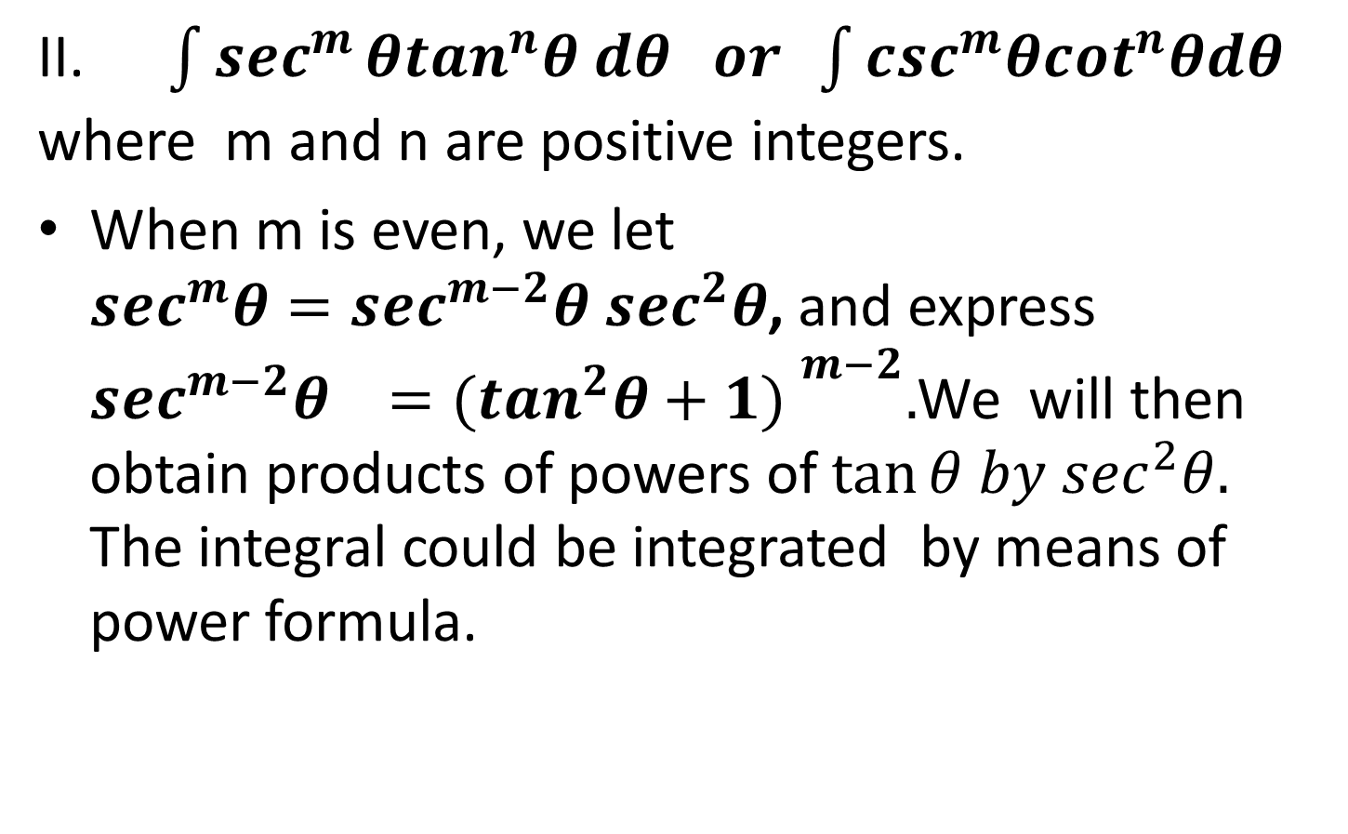
II. $\int{\sec^{m}}θ\tan^{n}θ dθ or \int{\csc^{m}θ\cot^{n}θdθ}$ where m and n are positive integers.
When m is even, we let $\sec^{m}θ=\sec^{m−2}θ \sec^{2}θ$, and express $\sec^{m−2}θ {=(\tan^{2}θ+1) }^{m−2}.$We will then obtain products of powers of $\tan{θ by \sec^{2}θ.}$ The integral could be integrated by means of power formula.

Slide 21
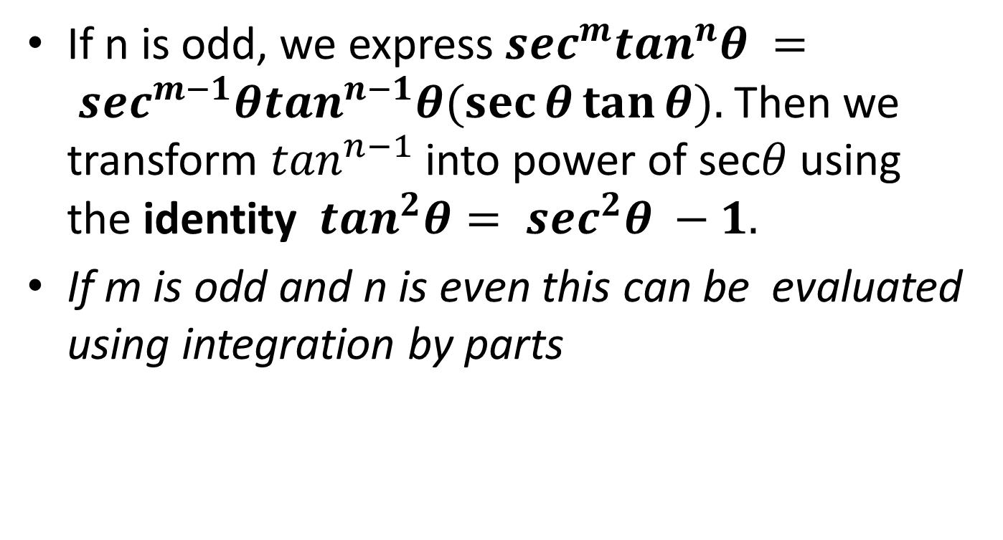
If n is odd, we express $\sec^{m}\tan^{n}θ = \sec^{m−1}θ\tan^{n−1}θ(\sec{θ\tan{θ).}}$Then we transform $\tan^{n−1}$into power of sec$θ$using the identity $\tan^{2}θ= \sec^{2}θ −1.$
If m is odd and n is even this can be evaluated using integration by parts

Slide 22
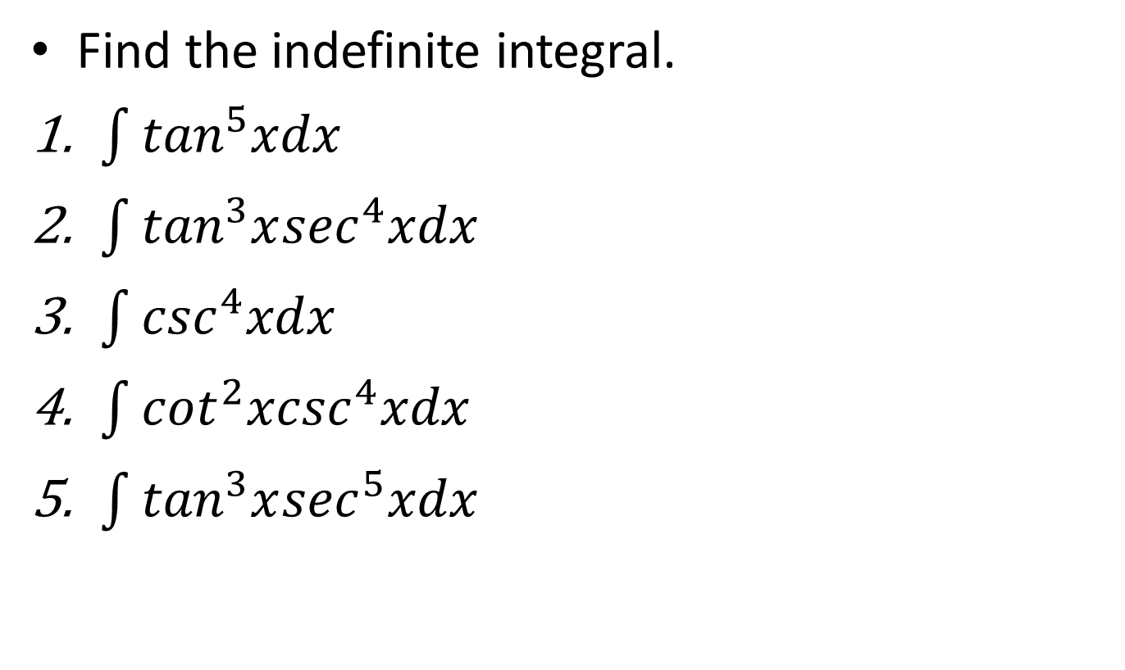
EXAMPLE
Find the indefinite integral.
$\int{\tan^{5}xdx}$
$\int{\tan^{3}x\sec^{4}xdx}$
$\int{\csc^{4}xdx}$
$\int{\cot^{2}x\csc^{4}xdx}$
$\int{\tan^{3}x\sec^{5}xdx}$

Slide 23
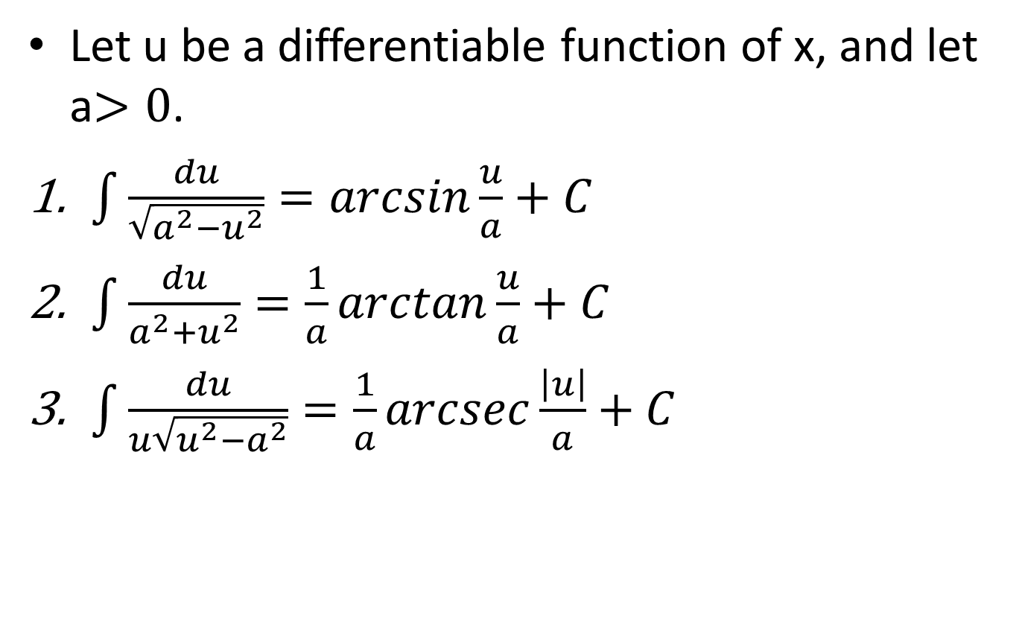
INTEGRALS INVOLVING INVERSE TRIGONOMETRIC FUNCTIONS
Let u be a differentiable function of x, and let a$>0$.
$\int{\frac{du}{\sqrt{a^{2}−u^{2}}}=arcsin\frac{u}{a}+C}$
$\int{\frac{du}{a^{2}+u^{2}}=\frac{1}{a}arctan\frac{u}{a}+C}$
$\int{\frac{du}{u\sqrt{u^{2}−a^{2}}}=\frac{1}{a}arcsec\frac{\left|u\right|}{a}+C}$

Slide 24
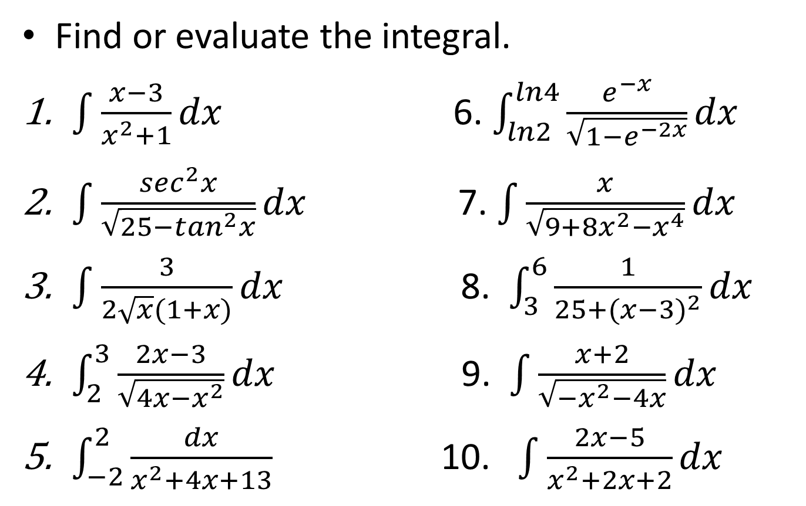
EXAMPLE
Find or evaluate the integral.
$\int{\frac{x−3}{x^{2}+1}dx}$ 6. $\int_{ln2}^{ln4}{\frac{e^{−x}}{\sqrt{1−e^{−2x}}}dx}$
$\int{\frac{\sec^{2}x}{\sqrt{25−\tan^{2}x}}dx}$ 7. $\int{\frac{x}{\sqrt{9+8x^{2}−x^{4}}}dx}$
$\int{\frac{3}{2\sqrt{x}(1+x)}dx}$ 8. $\int_{3}^{6}{\frac{1}{25+{(x−3)}^{2}}dx}$
$\int_{2}^{3}{\frac{2x−3}{\sqrt{4x−x^{2}}}dx}$ 9. $\int{\frac{x+2}{\sqrt{−x^{2}−4x}}dx}$
$\int_{−2}^{2}{\frac{dx}{x^{2}+4x+13}}$ 10. $\int{\frac{2x−5}{x^{2}+2x+2}dx}$

Slide 25
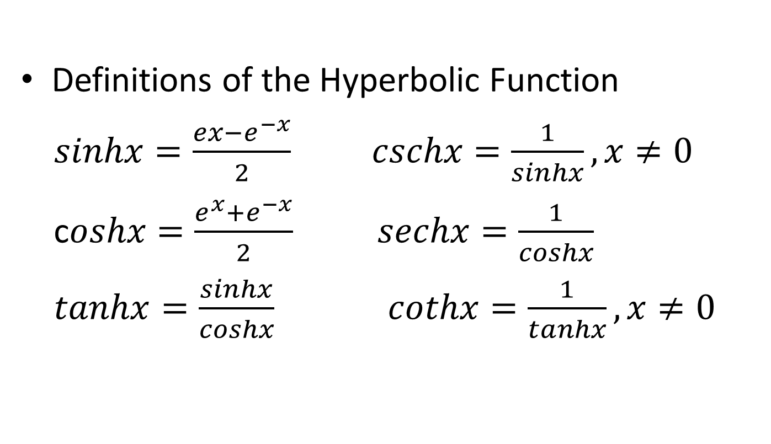
HYPERBOLIC FUNCTIONS
Definitions of the Hyperbolic Function
$sinhx=\frac{ex−e^{−x}}{2}$$cschx=\frac{1}{sinhx},x≠0$
c$oshx=\frac{e^{x}+e^{−x}}{2}$$sechx=\frac{1}{coshx}$
$tanhx=\frac{sinhx}{coshx}$$cothx=\frac{1}{tanhx},x≠0$

Slide 26
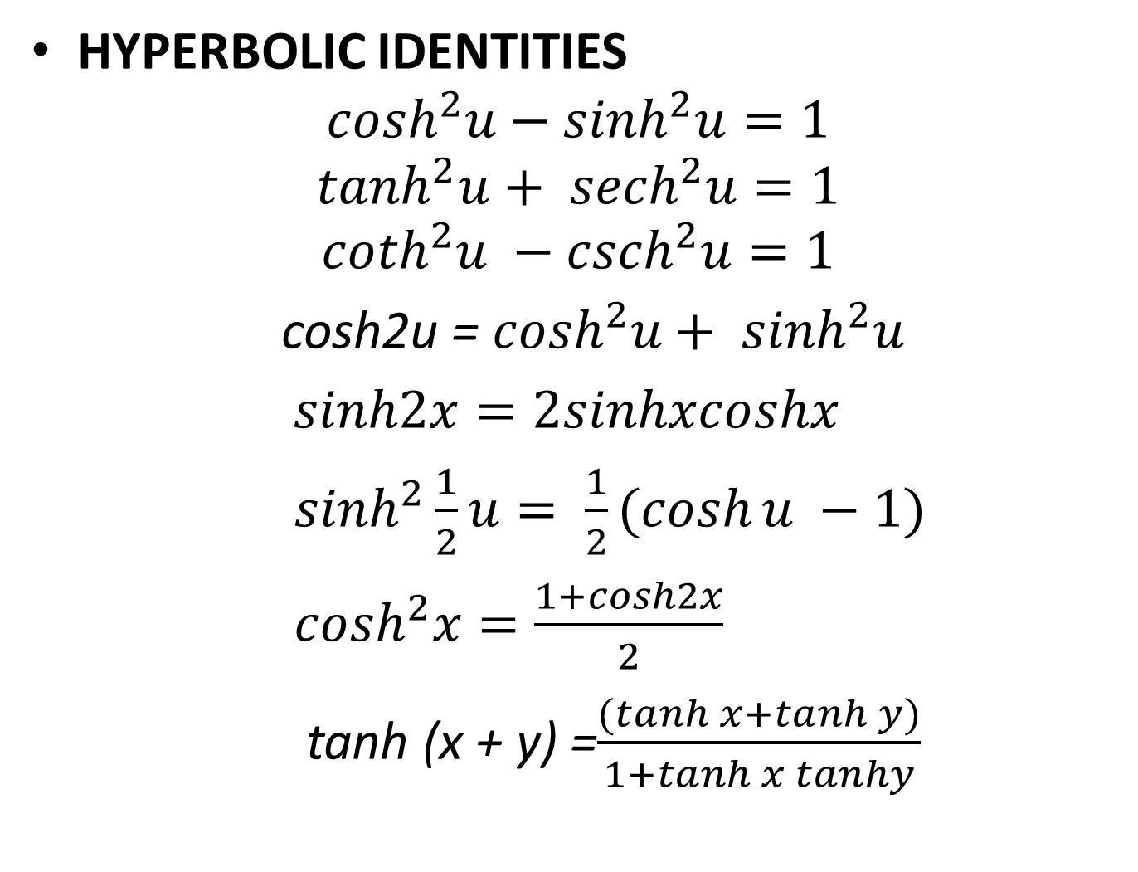
HYPERBOLIC IDENTITIES
$$\cosh^{2}u−\sinh^{2}u=1$$
$$\tanh^{2}u+ {sech}^{2}u=1$$
$$\coth^{2}u −{csch}^{2}u=1$$
cosh2u = $\cosh^{2}u+ \sinh^{2}u$
$sinh2x=2sinhxcoshx$
$\sinh^{2}\frac{1}{2}u= \frac{1}{2}(\cosh{u −1)}$
$\cosh^{2}x=\frac{1+cosh2x}{2}$
tanh(x + y) =$\frac{(\tanh{x+\tanh{y)}}}{1+\tanh{x tanhy}}$

Slide 27
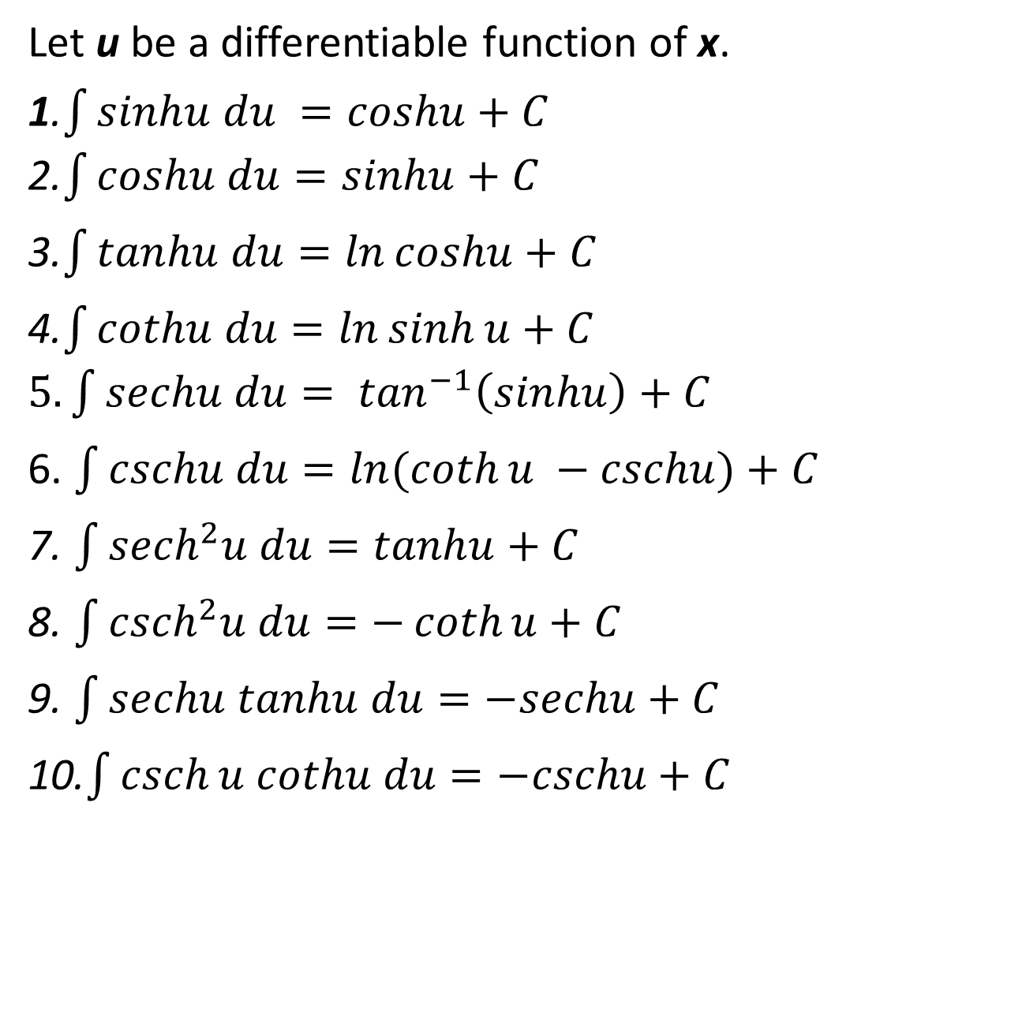
INTEGRALS OF HYPERBOLIC FUNCTIONS
Let u be a differentiable function of x.
1.$\int{sinhu du =coshu+C}$ 2.$\int{coshu du=sinhu+C}$
3.$\int{tanhu du=\ln{coshu+C}}$
4.$\int{cothu du=\ln{\sinh{u+C}}}$$5. \int{sechu du= \tan^{−1}\left(sinhu\right)+C}$
6. $\int{cschu du=\ln{(\coth{u −cschu)+C}} }$
7. $\int{{sech}^{2}u du=tanhu+C}$
8.$\int{{csch}^{2}u du=−\coth{u+C}}$
9. $\int{sechu tanhu du=−sechu+C}$
10.$\int{\operatorname{csch}{u cothu du=−cschu+C}}$

Slide 28
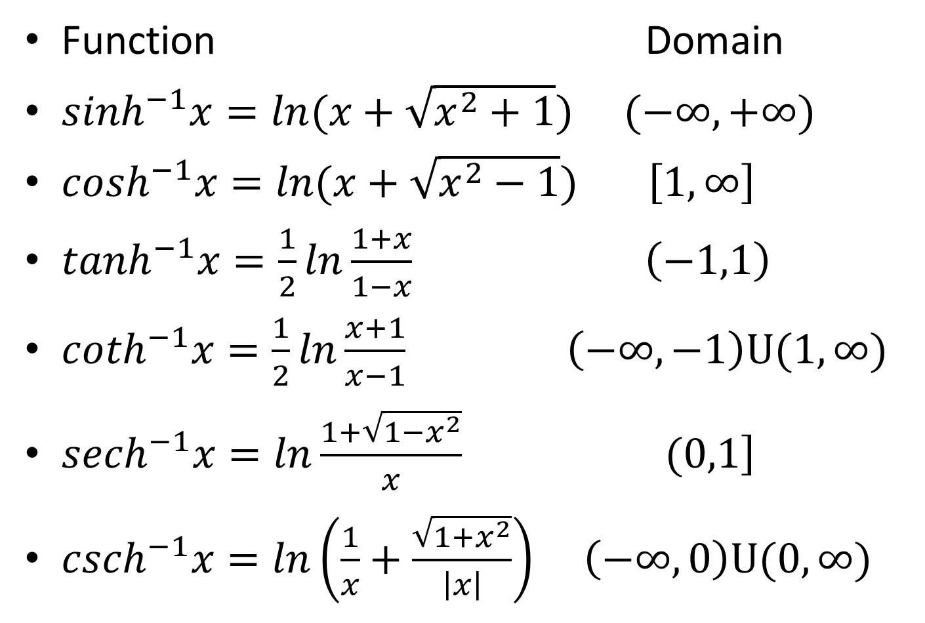
INVERSE HYPERBOLIC FUNCTIONS
Function Domain
$\sinh^{−1}x=ln(x+\sqrt{x^{2}+1})$$(−∞,+∞)$
$\cosh^{−1}x=ln(x+\sqrt{x^{2}−1})$$\left[1,∞\right]$
$\tanh^{−1}x=\frac{1}{2}ln\frac{1+x}{1−x}$$\left(−1,1\right)$
$\coth^{−1}x=\frac{1}{2}ln\frac{x+1}{x−1}$$\left(−∞,−1\right)U(1,∞)$
${sech}^{−1}x=ln\frac{1+\sqrt{1−x^{2}}}{x}$$\left.(0,1\right]$
${csch}^{−1}x=ln\left(\frac{1}{x}+\frac{\sqrt{1+x^{2}}}{\left|x\right|}\right)$$\left(−∞,0\right)U(0,∞)$

Slide 29
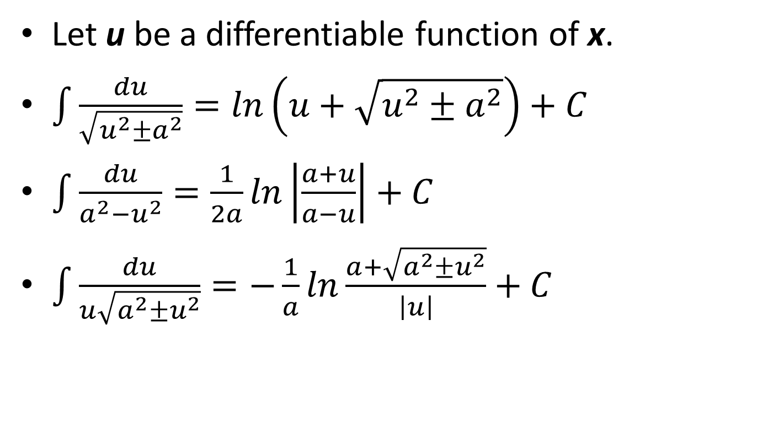
INTEGRATION INVOLVING INVERSE HYPERBOLIC FUNCTION
Let u be a differentiable function of x.
$\int{\frac{du}{\sqrt{u^{2}±a^{2}}}=ln\left(u+\sqrt{u^{2}±a^{2}}\right)+C}$
$\int{\frac{du}{a^{2}−u^{2}}=\frac{1}{2a}ln\left|\frac{a+u}{a−u}\right|+C}$
$\int{\frac{du}{u\sqrt{a^{2}±u^{2}}}=−\frac{1}{a}ln\frac{a+\sqrt{a^{2}±u^{2}}}{\left|u\right|}}+C$

Slide 30
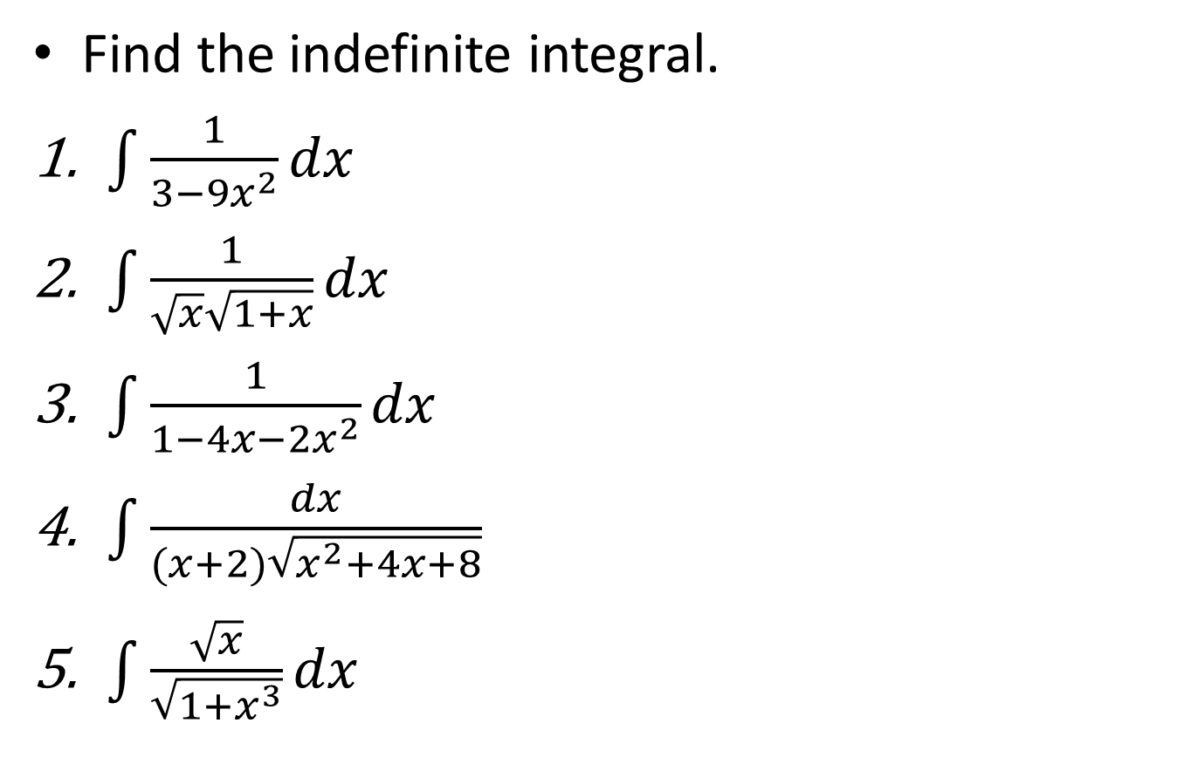
EXAMPLE
Find the indefinite integral.
$\int{\frac{1}{3−9x^{2}}dx}$
$\int{\frac{1}{\sqrt{x}\sqrt{1+x}}dx}$
$\int{\frac{1}{1−4x−2x^{2}}dx}$
$\int{\frac{dx}{(x+2)\sqrt{x^{2}+4x+8}}}$
$\int{\frac{\sqrt{x}}{\sqrt{1+x^{3}}}dx}$

